Slide 1
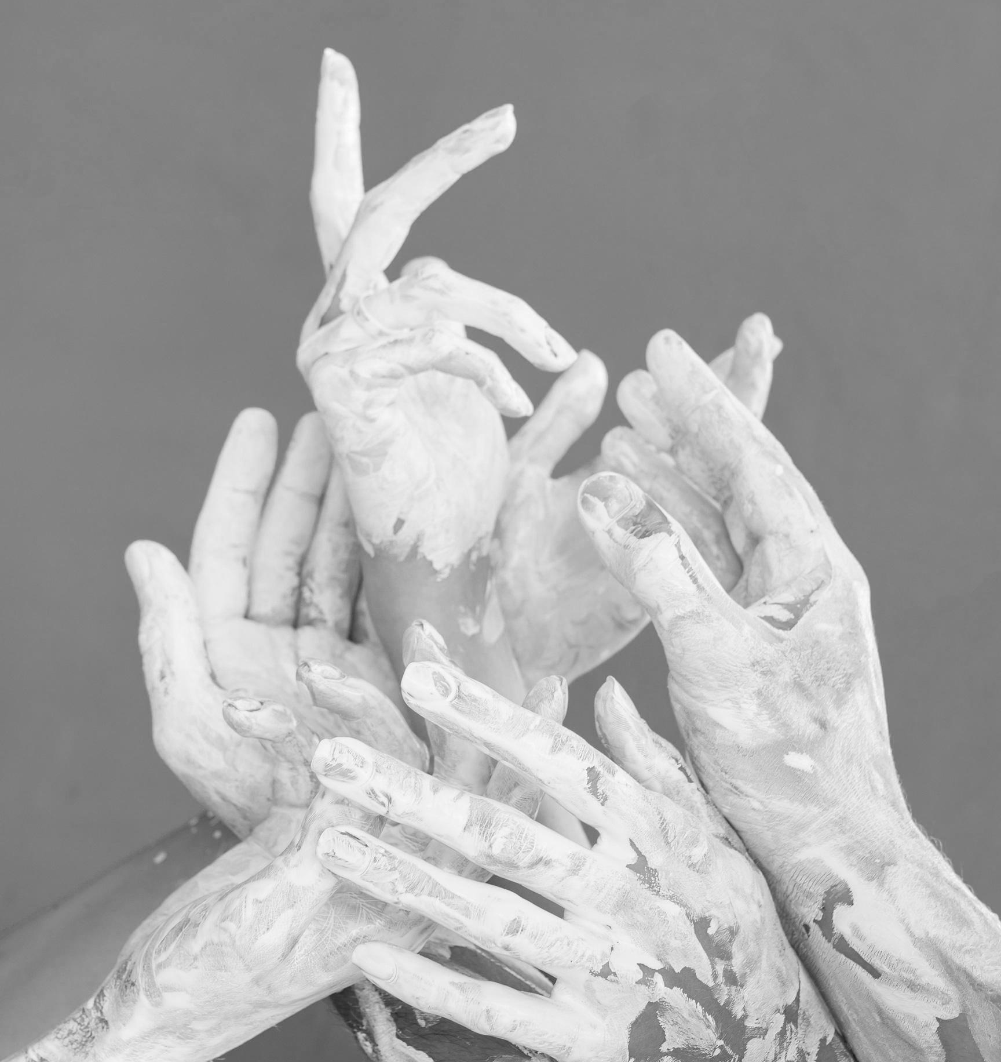
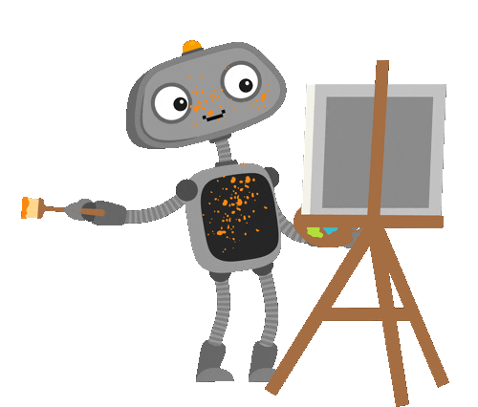
AI Art
By: Zurel Aviles

Slide 2

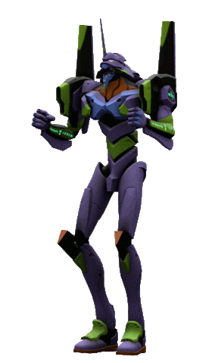
TABLE OF Contents
01
02
03
WHAT IS AI ART?
IMPACT ON ART & THE WORLD
ARTISTS RETALIATE
A basic and easy to understand explanation of what it is and how it works
Overview of how it has impacted not only art, but the entire world as well
Dives into how real artists have taken action against the machine

Slide 3
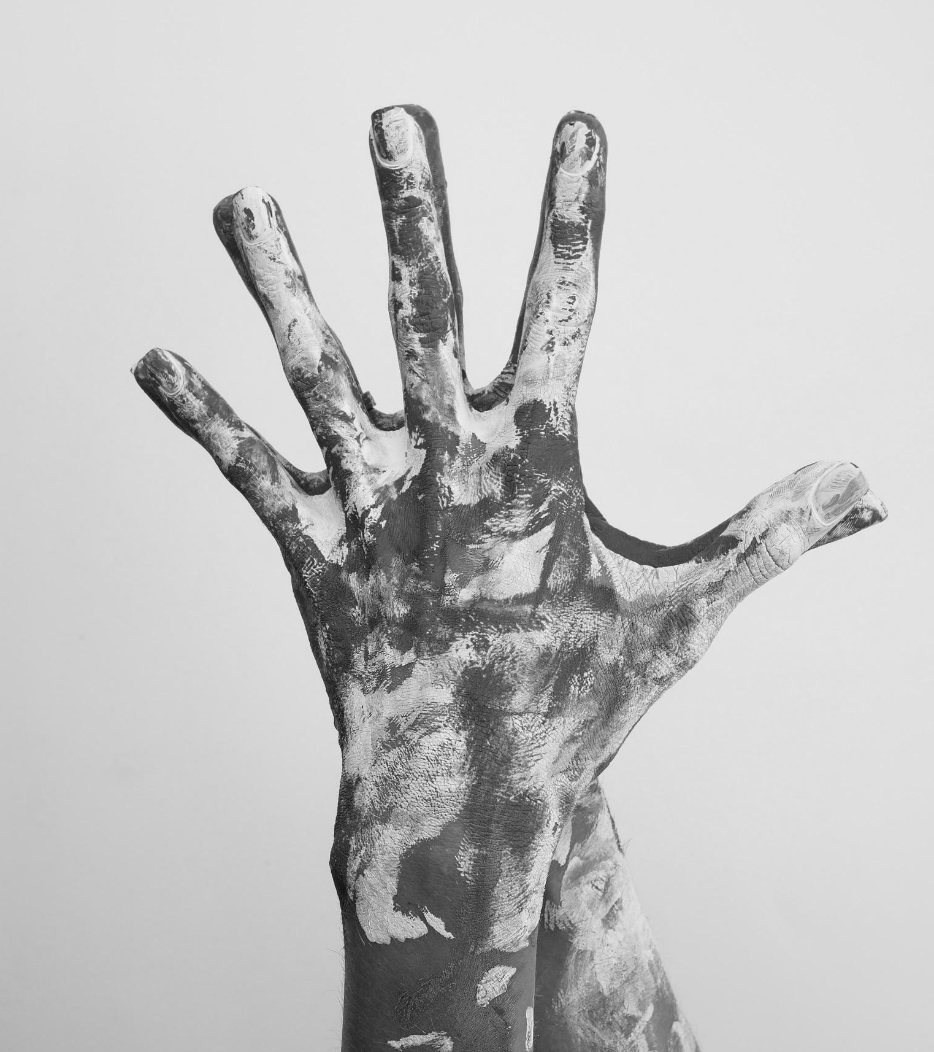
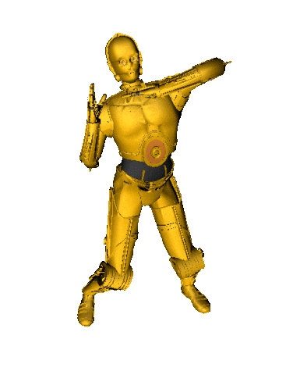
01
First section
WHAT IS AI ART AND HOW DOES IT WORK?

Slide 4
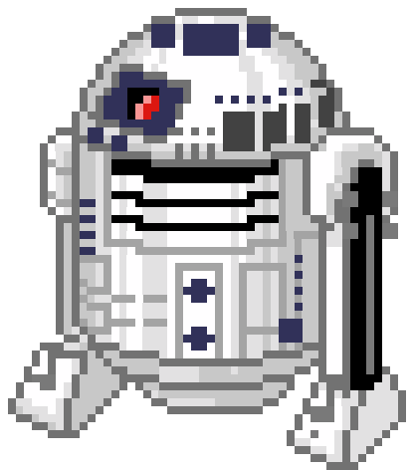
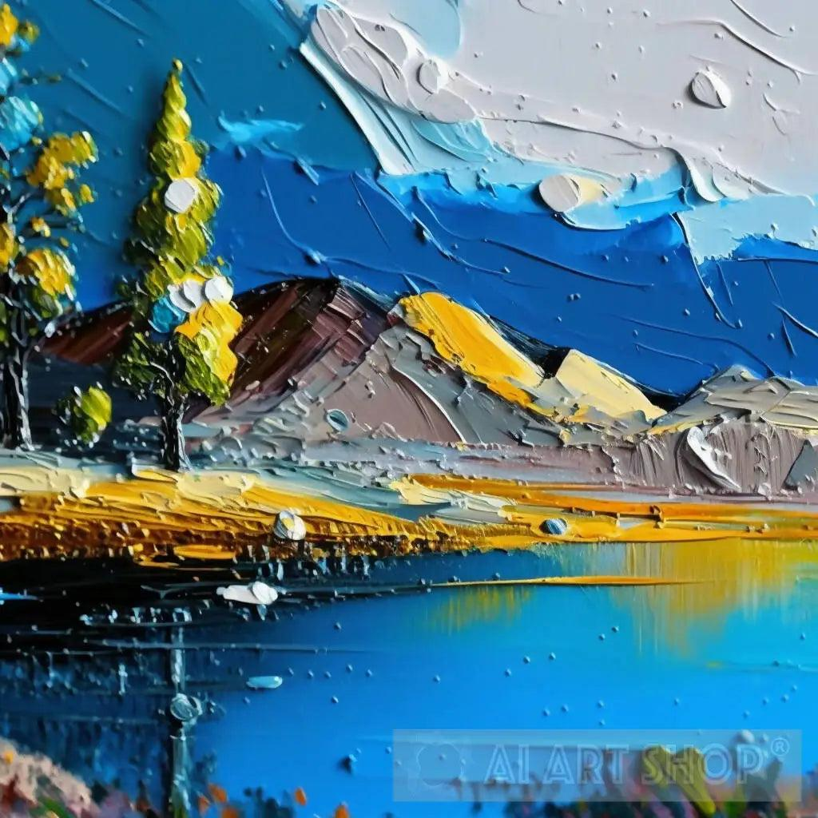
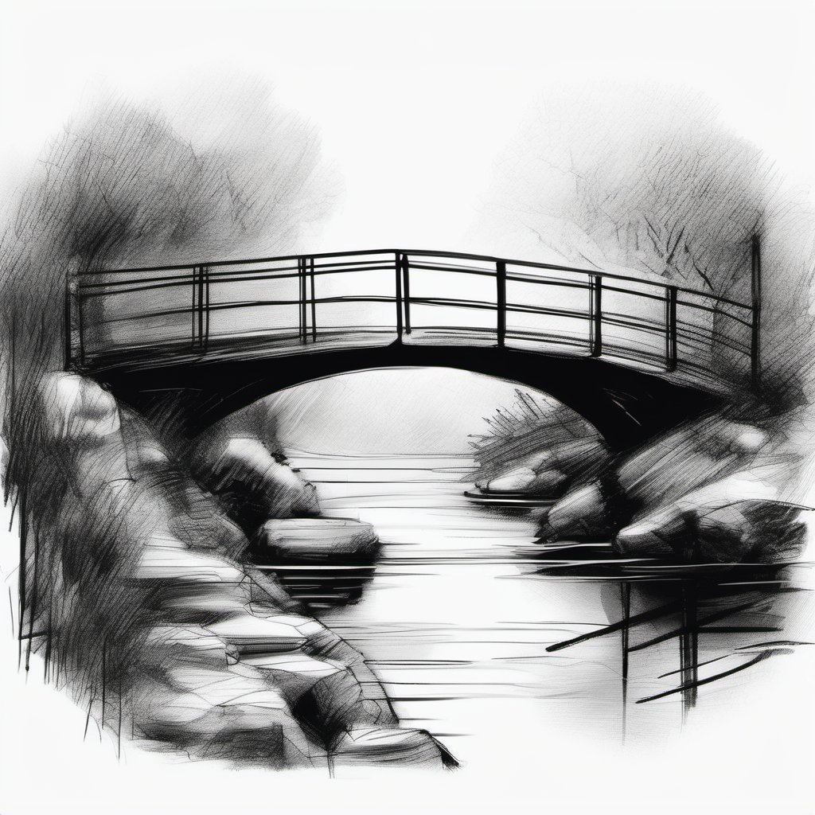
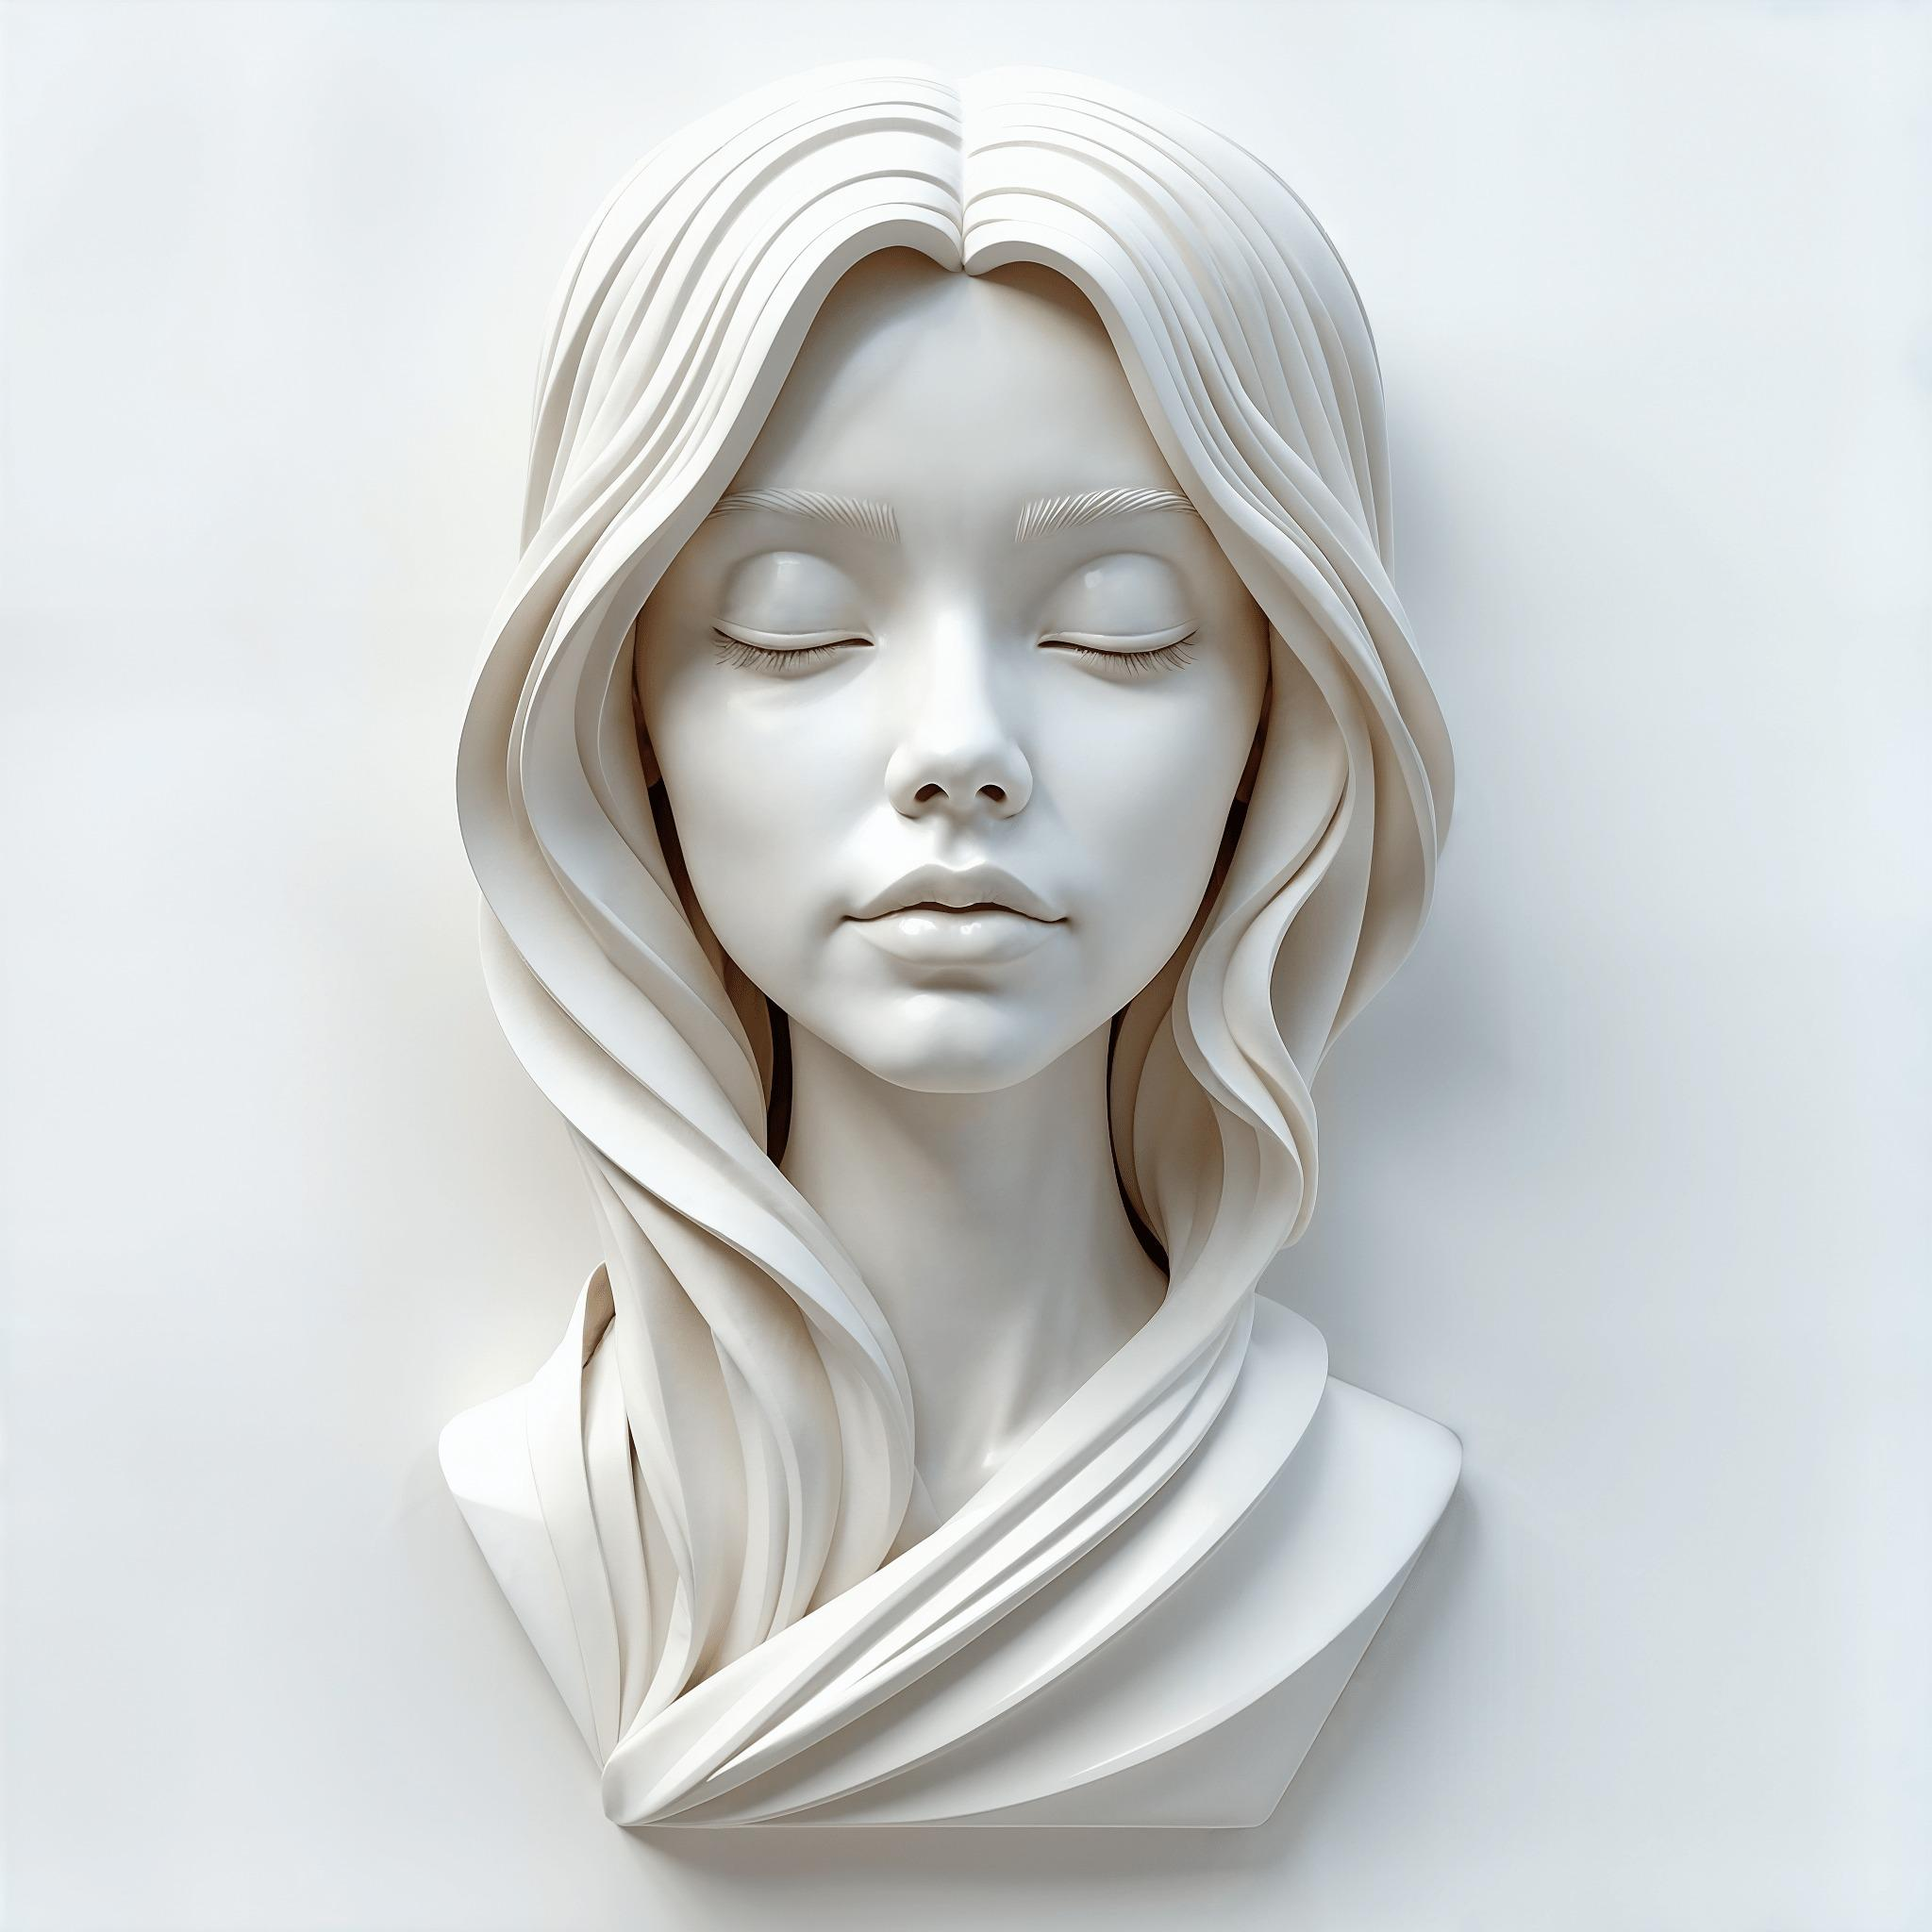
THE WHAT?
According to the Interaction Design Foundation, AI art is artwork created with the assistance of computer systems, which usually requires human input. These works can take various forms such as oil paintings, illustrations, sculptures, poetry, and even music.

Slide 5
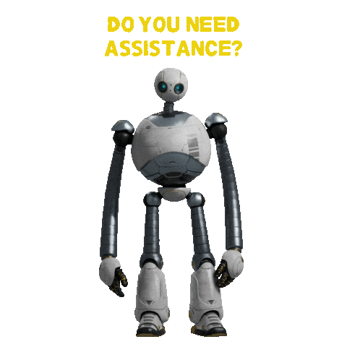
THE HOW?
The process of creating these works first begins with a set of input data, such as photographs, drawings, or paintings, which the AI will then use to learn about styles, textures, composition. Once it has been fed this data, images will be generated autonomously or based on prompts given by a human user.
Ex: generate a pastel portrait of the Mona Lisa

Slide 6
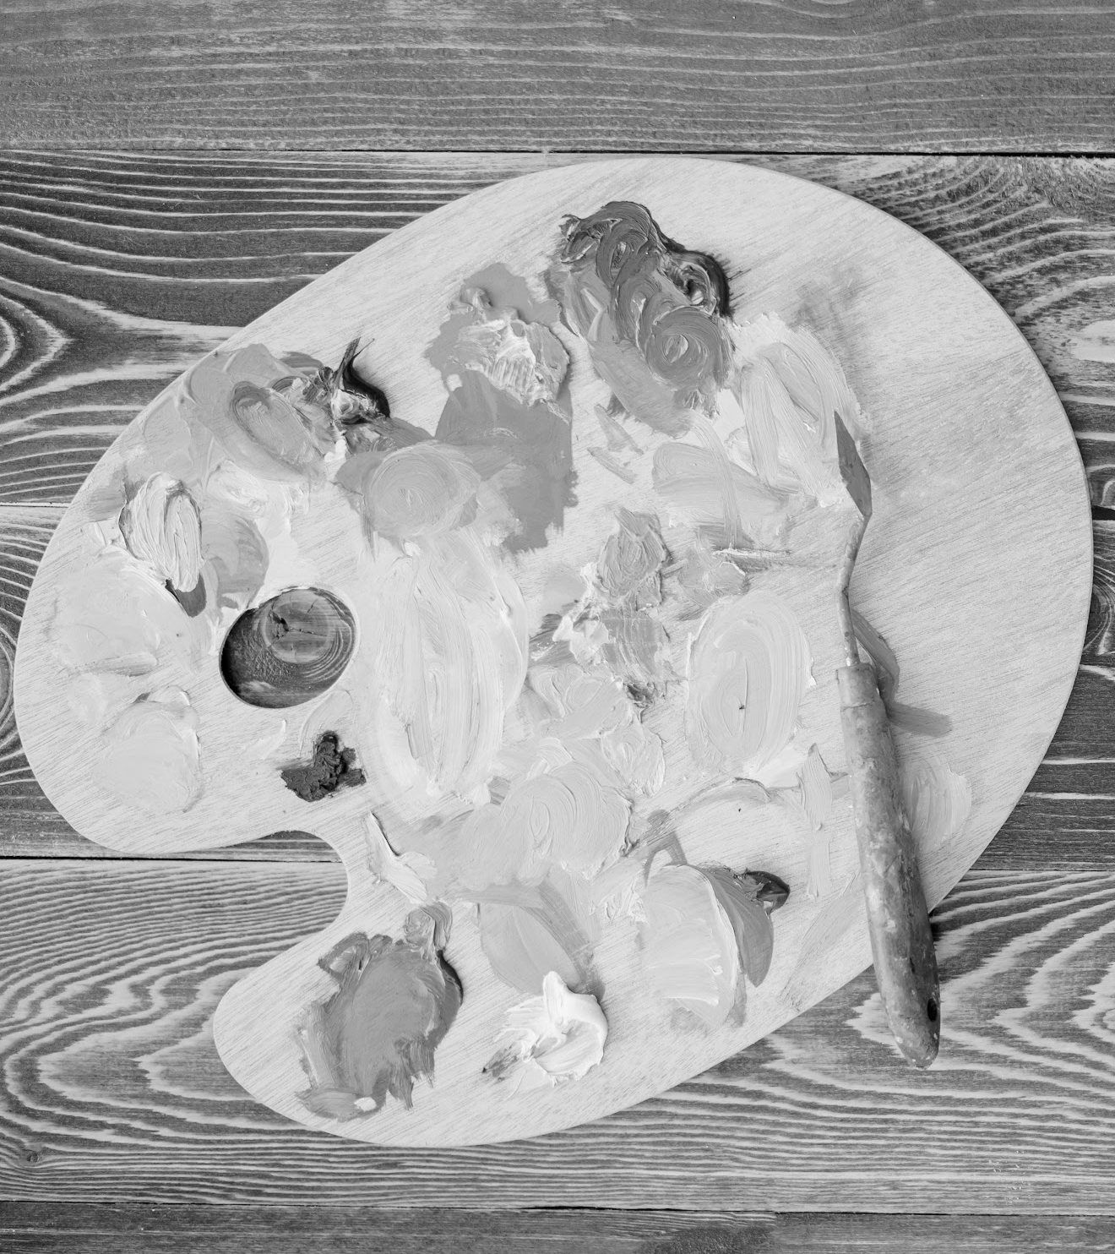
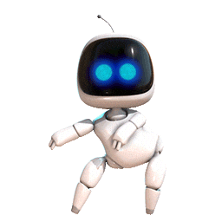
02
SECOND section
THE IMPACT ON ART & THE WORLD

Slide 7
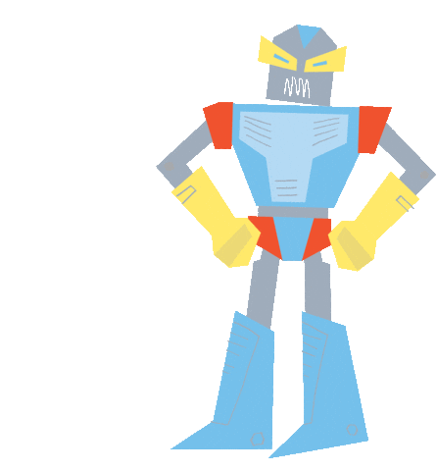
EFFECTS On REAL ART
Though generating images with AI may seem like all fun and games, in reality, it’s doing more harm than good, especially towards real people who have dedicated time and money to their craft. For example;
In 2024, Pokémon hosted an art contest where artists could have the chance win $5,000 and have their submission put on a physical card. Soon after the top 300 entries were announced, it was revealed that 6 of the qualifiers were fully AI, which violated the rules of the competition and left legitimate artists no chance of getting a spot.
Most, if not all, of the data that gets fed into these algorithms belongs to an actual artist, musician, poet, etc. The companies that use these works either don't have permission to use them or never compensate the person. Leaving many creatives struggling to find work because consumers are using AI rather than going out of their way to pay for the real thing.

Slide 8
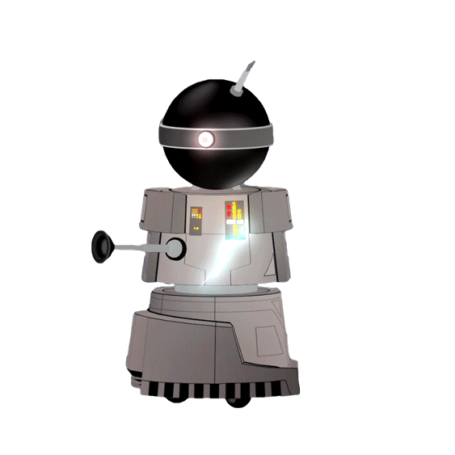
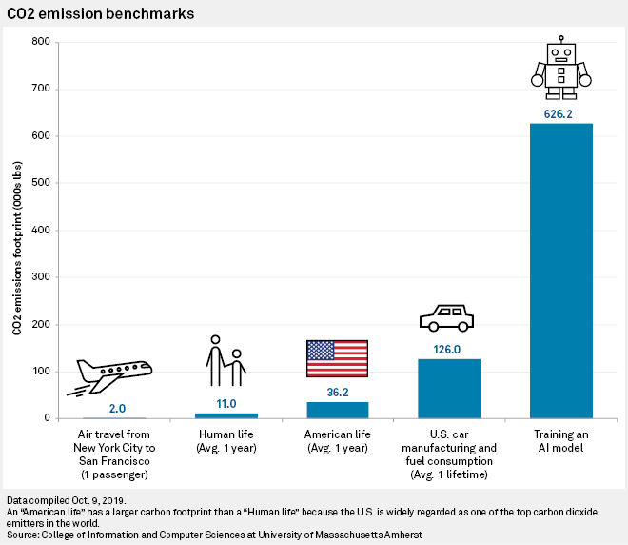
EFFECTS On OUR WORLD
Believe it or not, AI isn't just a nuisance for the art world, but the rest of humanity as well. It may come as a surprise to some, but the reality of the situation is that AI has been helping in the stagnant decline of our environment;
In a graph sourced from the University of Massachusetts Amherst, training an AI model emitted over 626,000 pounds of CO2 in 2019 alone. That's more than the average fuel consumption of a single car.
According to the University of Illinois, the annual water consumption is projected to reach between 4.2 billion and 6.6 billion cubic meters by 2027
The International Energy estimates that by 2026 electricity consumption by data centers, including artificial intelligence, could reach 4% of annual global energy usage

Slide 9
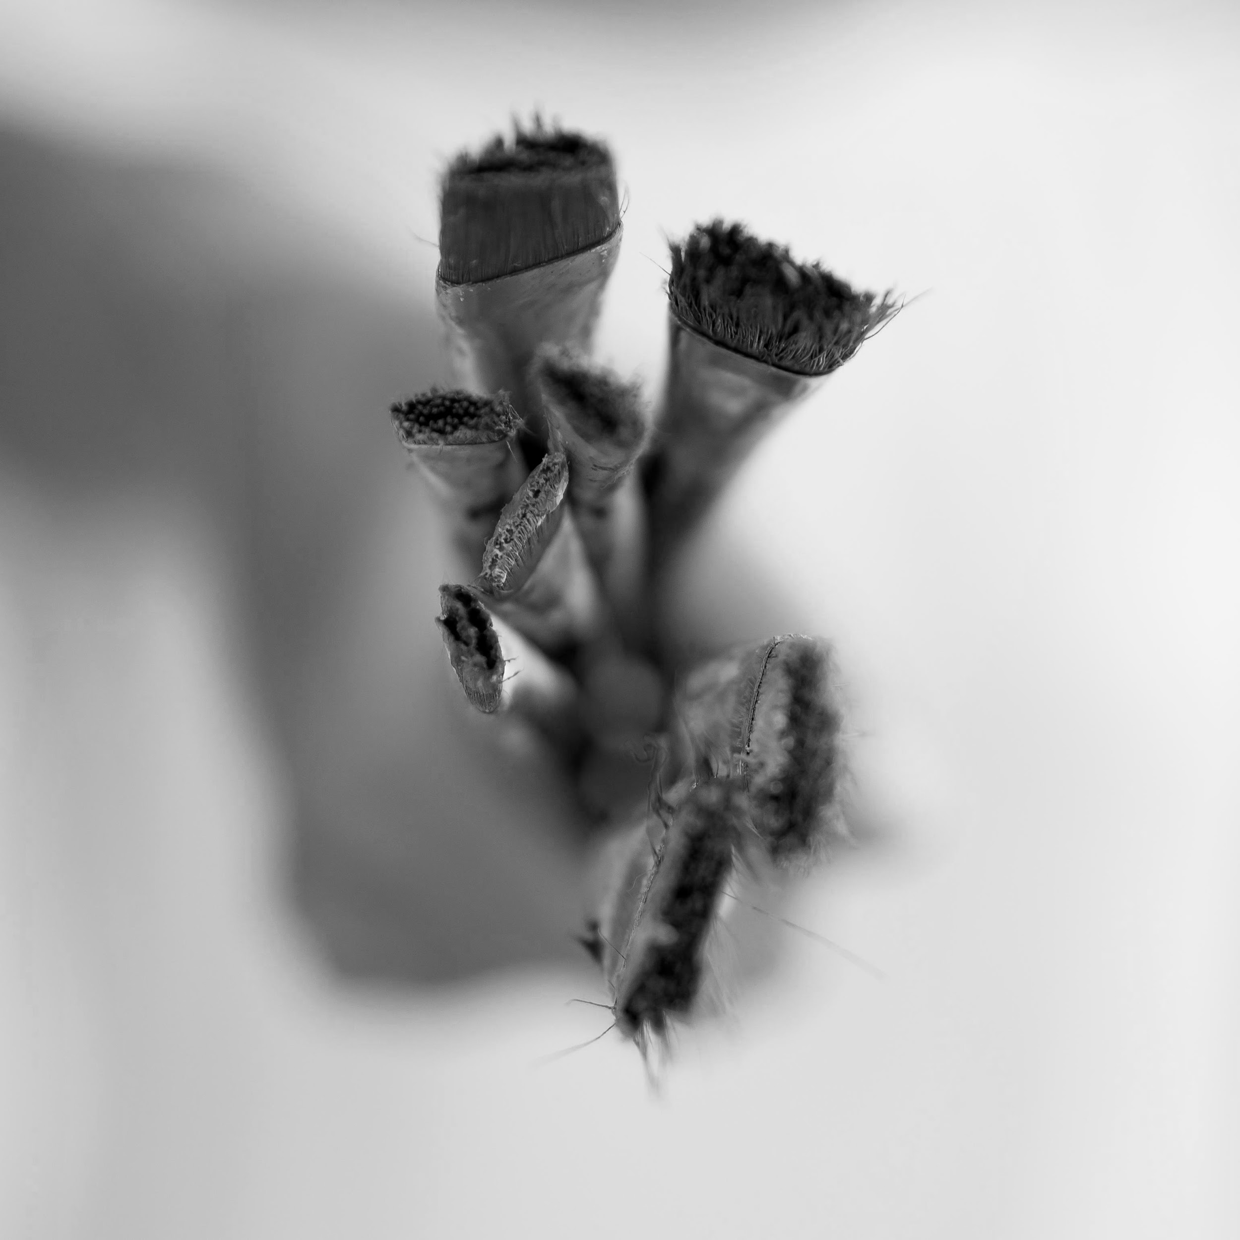
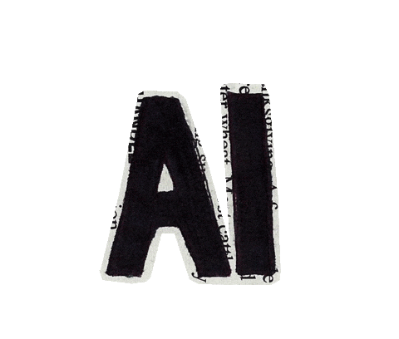
03
THIRD section
ARTISTS RETALIATE

Slide 10
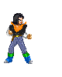
lAWSUITS
Despite the continuous disrespect towards full-time artists by AI companies, its been shown in recent years and even months, that when it comes to someone's livelihood their not going to back down without a fight. This much is shown through the actions of creatives like:
Sarah Anderson, Kelly McKernan, and Karla Ortiz, who all sued Stability AI, DeviantArt, and Midjourney for violating the rights of millions of artists’ by illegally storing their works and then producing fakes that overshadowed the originals. Though two of the businesses had nothing to say, in court Stability AI denied any copyright infringement was going on.
The Recording Industry Association of America who sued both Suno and Udio, multi-million dollar companies, for mass infringement of copyrighted sound recordings. The plaintiffs behind the association include UMG, Sony Music Entertainment, and Warner Records, labels that represent major artists, such as Kendrick Lamar, Taylor Swift, SZA, and Bruno Mars.

Slide 11
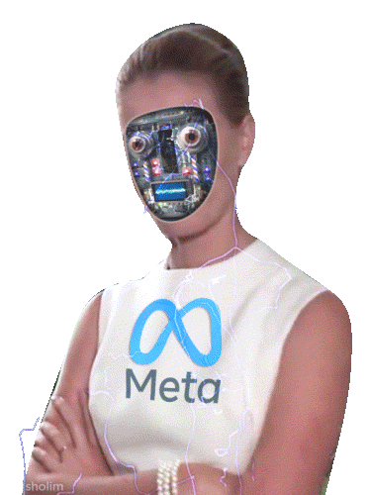
TOOLS
However, for artists who either don’t have the money to file a case or don’t have a big enough following, there are other ways to disrupt the algorithm and ensure your art isn’t victim to the grubby little hands of AI. Such as,
Nightshade, developed by Professor Ben Zhao and his team at the University of Chicago, is a tool that turns any image into unsuitable learning material for AI by mismatching the image and text.
Glaze, which slightly alters the pixels within an artwork to the point where it’s hard for AI to mimic the specific art style used
Kudurru, created by Spawning.ai, tracks the IP addresses of automated bots and blocks their attempts to scrape your data. It can even send back a virtual middle finger, or an unwanted “Rickroll”

Slide 12


nolifelad on Instagram

Slide 13

ReFERENCES
https://www.interaction-design.org/literature/topics/ai-generated-art?srsltid=AfmBOooDroXhEbOOVNwZRN9TXVtXbwFxidVEpH7e9dViBHAmmSQRe1Xf
https://www.ign.com/articles/pokmon-disqualifies-trading-card-art-contest-participants-amid-ai-allegations
https://libguides.ecu.edu/c.php?g=1395131&p=10318505
https://cee.illinois.edu/news/AIs-Challenging-Waters
https://www.cbsnews.com/sanfrancisco/news/ai-visual-artists-fight-back-repurposing-work-sf-federal-court/
https://www.riaa.com/record-companies-bring-landmark-cases-for-responsible-ai-againstsuno-and-udio-in-boston-and-new-york-federal-courts-respectively/
https://www.npr.org/2023/11/03/1210208164/new-tools-help-artists-fight-ai-by-directly-disrupting-the-systems

